Slide 1

RESTRICTED
Electronic Equipment CPU Temperature Review

Slide 2
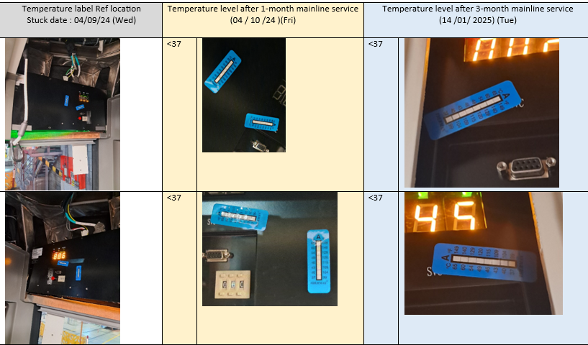
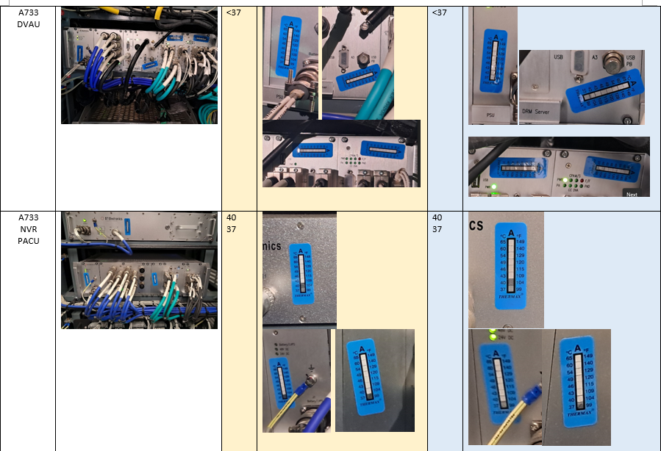
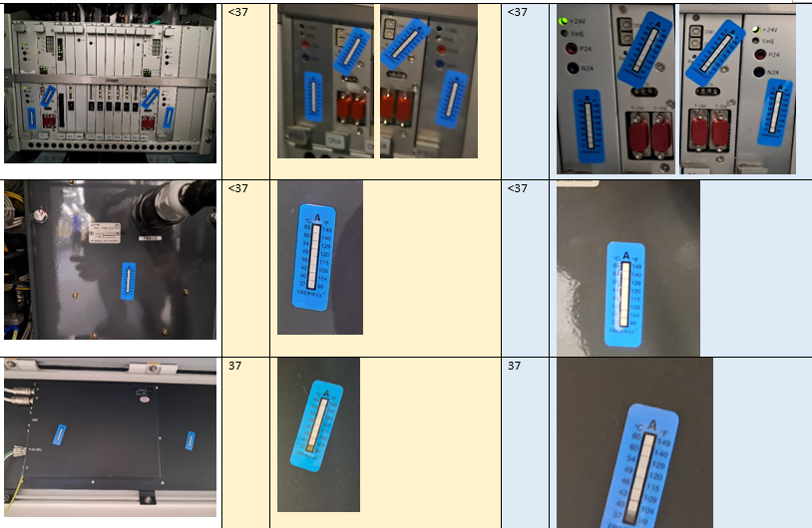
Q-train Electronic Temperature Review Result
Temperature label review date : 14/01/2025, 11/06/2025
Assessment was carried out on all electronic systems. Results show the maximum temperature are well within specification of <70 degrees C.
 | Car | Equipment | Max. temp logged (℃) (after 3-months service) | Max. temp logged (℃) (about 1year service)
1 | A733 | EDD | <37 | 37
2 |  | ETND | <37 | 40
3 |  | In-cab CCTV Controller | <37 | 40
4 |  | TMS-DU | 37 | 37
5 |  | TRHU | 40 | 40
6 |  | DVAU | 37 | 40
7 |  | PACU | 37 | 40
8 |  | TMS-CU | <37 | 40
9 |  | PWM | <37 | <37
10 |  | DRM | 37 | 37
11 |  | EDCU | 40 | 40
12 |  | TVS | 40 | 40
13 |  | IOBCS | 46 | 49
14 |  | Smart Server | 37 | 40
15 |  | FDU | <37 | <37
16 |  | LU | 40 | 40
17 |  | EBCU | <37 | <37
18 |  | display | 37 | 37
19 |  | CCTV | <37 | <37
20 | C773 | GCU | 49 | 49
21 |  | TMS-LU | <37 | <37
22 |  | Audio amp | <37 | <37
23 |  | PACU | 37 | 37
24 |  | DRM | 37 | 37
25 |  | EDCU | 40 | 40
26 |  | display | 37 | 37
27 |  | CCTV | <37 | <37
28 | B733 | GCU | 49 | 49
29 | C967 | TMS-ER | 40 | 40

